Slide 1

Integer Linear Programming
Further Problems

Slide 2
Blank Slide

Slide 3

Minimum Set Cover

Slide 4
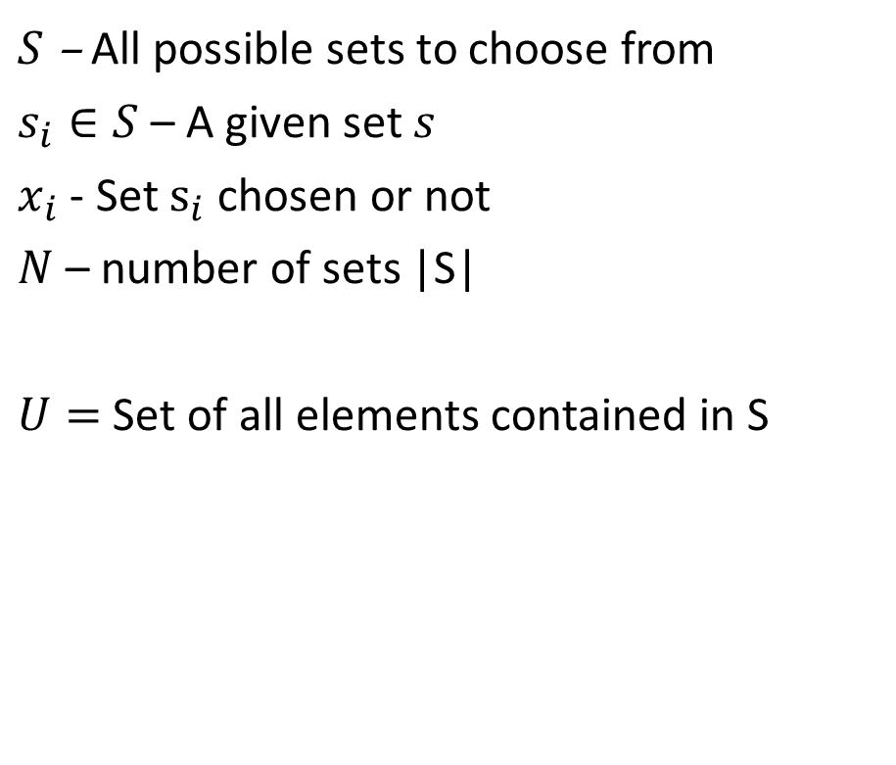

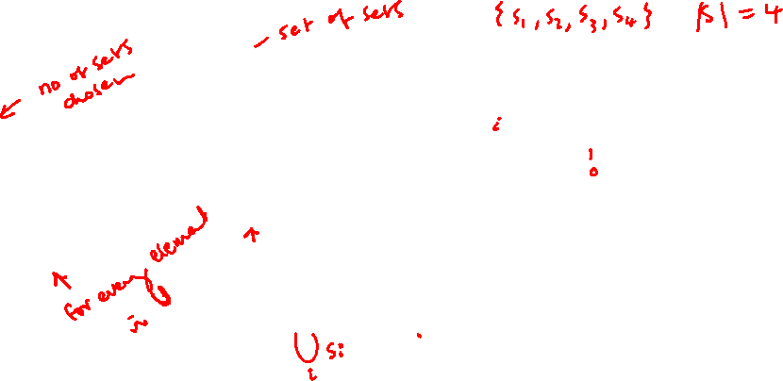
General Set Covering Problem
minimise
$$\sum_{i=1}^{N}{x_{i}}$$
subject to:
$$\sum_{i:e∈s_{i}}{x_{i}≥1}, ∀e∈U$$
$$x_{i}∈\{0,1\}$$
$S$ – All possible sets to choose from
$s_{i}∈S$ – A given set $s$
$x_{i}$ - Set $s_{i}$ chosen or not
$N$ – number of sets |S|
$U=$ Set of all elements contained in S

Slide 5
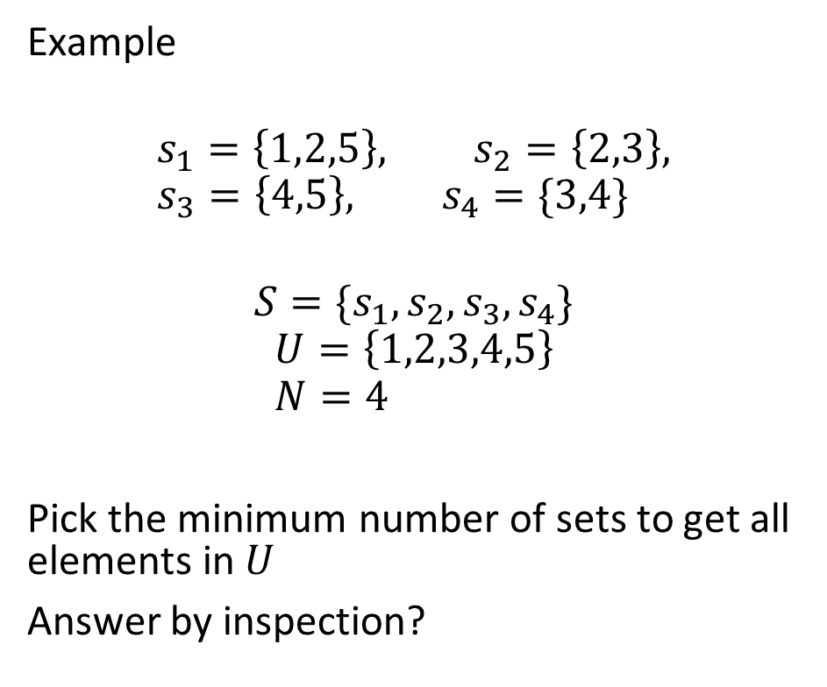
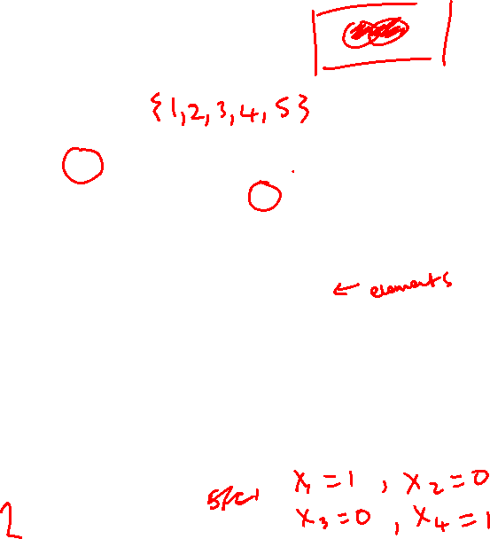
General Set Covering Problem
minimise
$$\sum_{i=1}^{N}{x_{i}}$$
subject to:
$$\sum_{i:e∈s_{i}}{x_{i}≥1}, ∀e∈U$$
$$x_{i}∈\{0,1\}$$
Example
$$s_{1}=\left\{1,2,5\right\}, s_{2}=\left\{2,3\right\}, s_{3}=\left\{4,5\right\}, s_{4}=\{3,4\}$$
$$S=\{s_{1},s_{2},s_{3},s_{4}\}$$
$$U=\left\{1,2,3,4,5\right\} \\ N=4$$
Pick the minimum number of sets to get all elements in $U$
Answer by inspection?

Slide 6

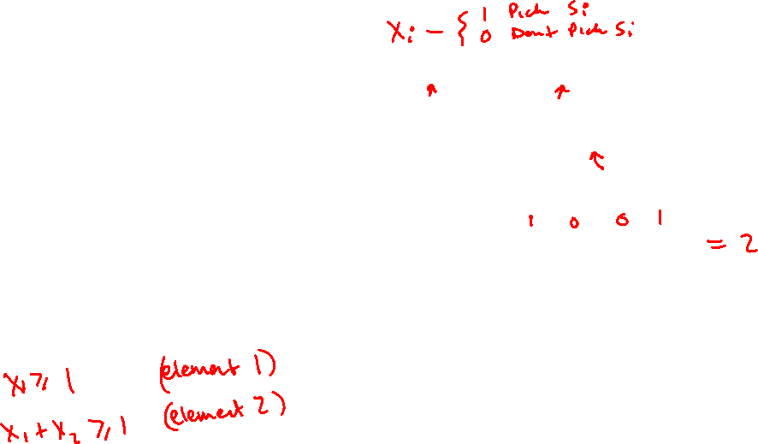

General Set Covering Problem
minimise
$$\sum_{i=1}^{N}{x_{i}}$$
subject to:
$$\sum_{i:e∈s_{i}}{x_{i}≥1}, ∀e∈U$$
$$x_{i}∈\{0,1\}$$
$$s_{1}=\left\{1,2,5\right\}, s_{2}=\left\{2,3\right\}, s_{3}=\left\{4,5\right\}, s_{4}=\{3,4\}$$
$$S=\{s_{1},s_{2},s_{3},s_{4}\}$$
$$U=\left\{1,2,3,4,5\right\} \\ N=4$$
minimise
$$x_{1}+x_{2}+x_{3}+x_{4}$$
subject to:
$$x_{1}≥1 \\ x_{1}+x_{2}≥1 \\ x_{2}+x_{4}≥1 \\ x_{3}+x_{4}≥1 \\ x_{1}+x_{5}≥1$$
$$x_{s}∈\{0,1\}$$
(Element 1)
(Element 2)
(Element 3)
(Element 4)
(Element 5)
Minimum set cover 2
$$\{s_{1},s_{4}\}$$

Slide 7
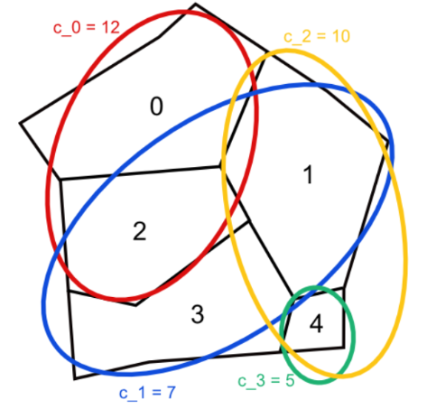
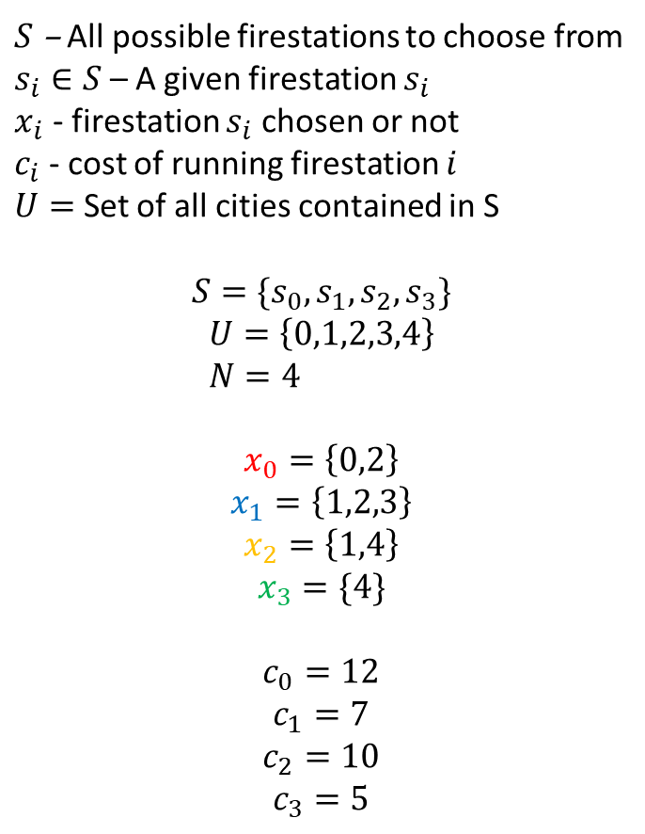
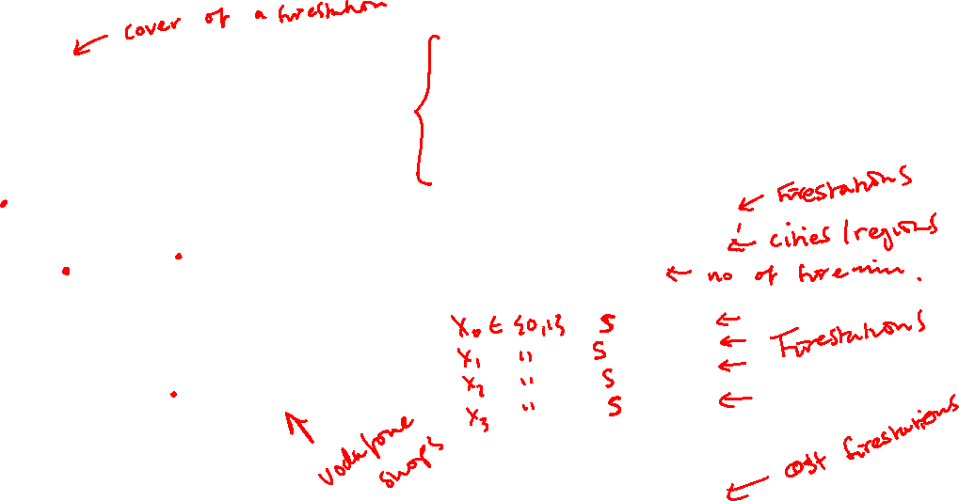
Costed Firestation example
$S$ – All possible firestations to choose from
$s_{i}∈S$ – A given firestation $s_{i}$
$x_{i}$ - firestation $s_{i}$ chosen or not
$c_{i}$ - cost of running firestation $i$
$U=$ Set of all cities contained in S
$$S=\{s_{0},s_{1},s_{2},s_{3}\}$$
$$U=\left\{0,1,2,3,4\right\} \\ N=4$$
$$x_{0}=\left\{0,2\right\}$$
$$x_{1}=\left\{1,2,3\right\}$$
$$x_{2}=\left\{1,4\right\}$$
$$x_{3}=\{4\}$$
$$c_{0}=12$$
$$c_{1}=7$$
$$c_{2}=10$$
$$c_{3}=5$$

Slide 8
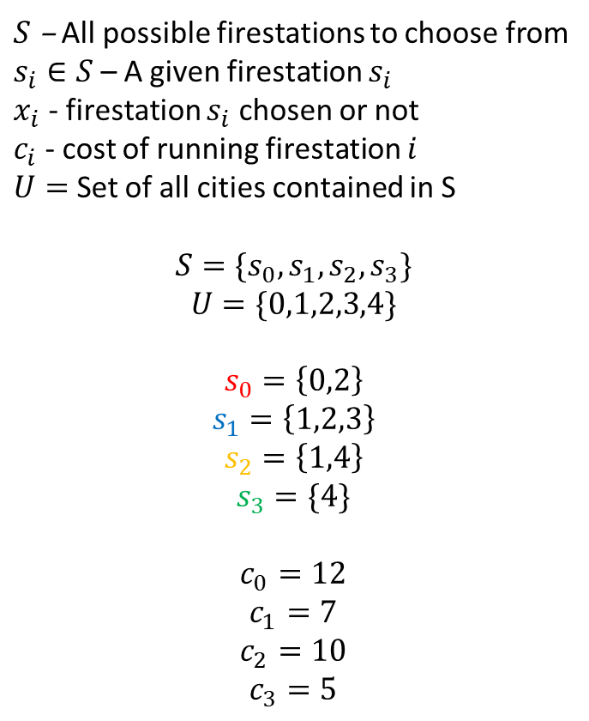
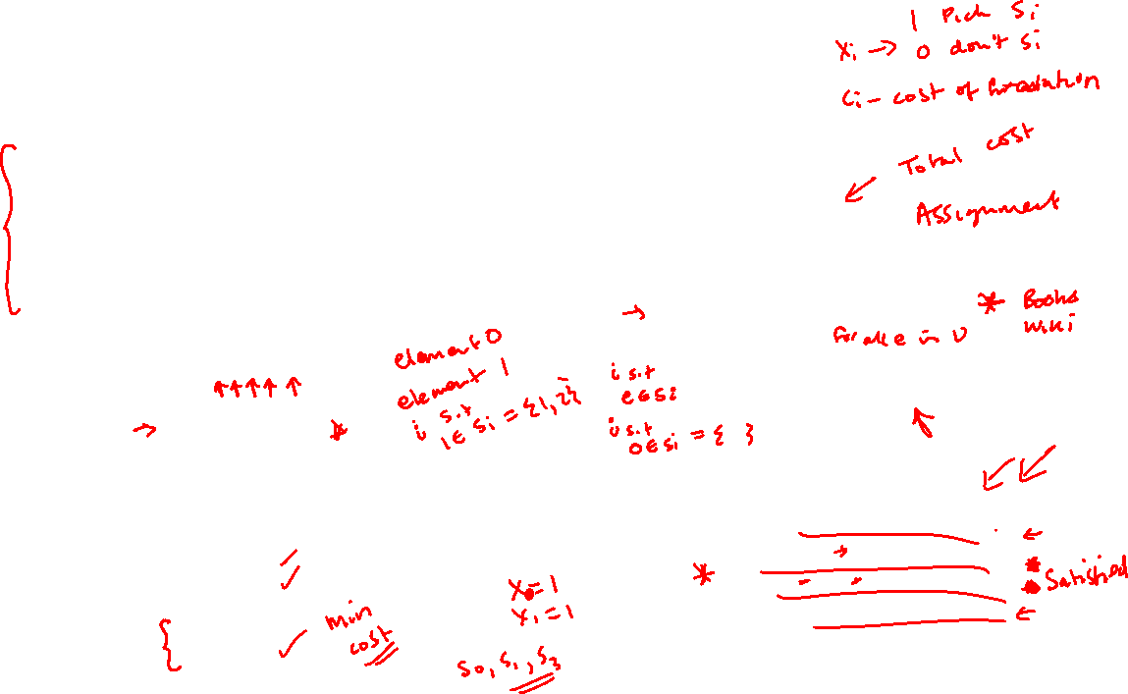


Costed Firestation example
$S$ – All possible firestations to choose from
$s_{i}∈S$ – A given firestation $s_{i}$
$x_{i}$ - firestation $s_{i}$ chosen or not
$c_{i}$ - cost of running firestation $i$
$U=$ Set of all cities contained in S
$$S=\{s_{0},s_{1},s_{2},s_{3}\}$$
$$U=\{0,1,2,3,4\}$$
$$s_{0}=\left\{0,2\right\}$$
$$s_{1}=\left\{1,2,3\right\}$$
$$s_{2}=\left\{1,4\right\}$$
$$s_{3}=\{4\}$$
$$c_{0}=12$$
$$c_{1}=7$$
$$c_{2}=10$$
$$c_{3}=5$$
minimise
$$\sum_{i=1}^{N}{{c_{i}x}_{i}}$$
subject to:
$$\sum_{i:e∈s_{i}}{x_{i}≥1}, ∀e∈U$$
$$x_{i}∈\{0,1\}$$
minimise
$$c_{0}x_{0}+c_{1}x_{1}+c_{2}x_{2}+c_{3}x_{3}$$
subject to:
$x_{0}≥1$
$x_{1}+x_{2}≥1$
$x_{0}+x_{1}≥1$
$x_{1}≥1$
$$x_{2}+x_{3}≥1$$
$$x_{s}∈\{0,1\}$$
(City 0)
(City 1)
(City 2)
(City 3)
(City 4)

Slide 9
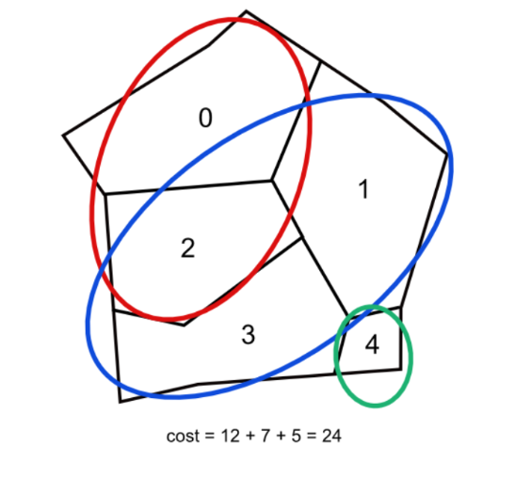

Costed Firestation example
$S$ – All possible firestations to choose from
$s_{i}∈S$ – A given firestation $s_{i}$
$x_{i}$ - firestation $s_{i}$ chosen or not
$c_{i}$ - cost of running firestation $i$
$U=$ Set of all cities contained in S
$$S=\{s_{0},s_{1},s_{2},s_{3}\}$$
$$U=\{0,1,2,3,4\}$$
$$s_{0}=\left\{0,2\right\}$$
$$s_{1}=\left\{1,2,3\right\}$$
$$s_{2}=\left\{1,4\right\}$$
$$s_{3}=\{4\}$$
$$c_{0}=12$$
$$c_{1}=7$$
$$c_{2}=10$$
$$c_{3}=5$$

Slide 10
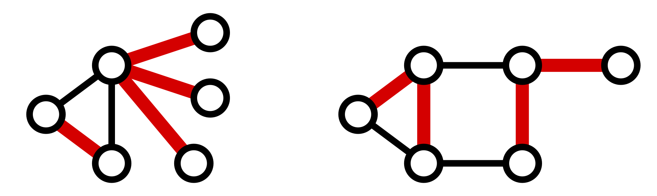
Edge Covering
Find a set of edges that cover the vertices…
e.g.

Slide 11
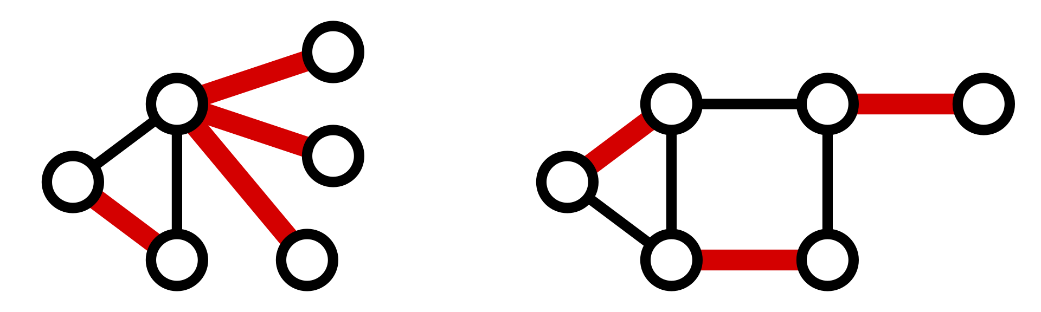
Minimum Edge Covering
Find a the minimum number of edges that cover the vertices…
e.g.

Slide 12

Minimum Vertex Cover

Slide 13
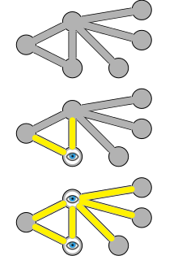
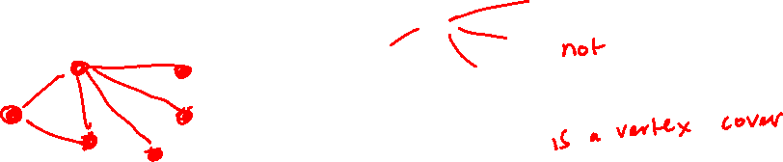
Vertex Cover
A set of vertices that includes at least one endpoint of every edge

Slide 14
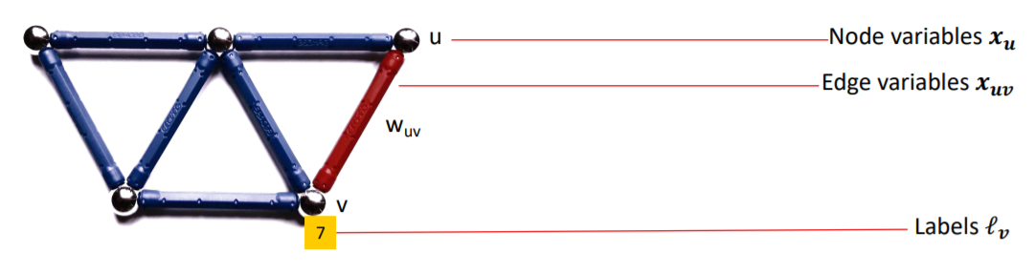
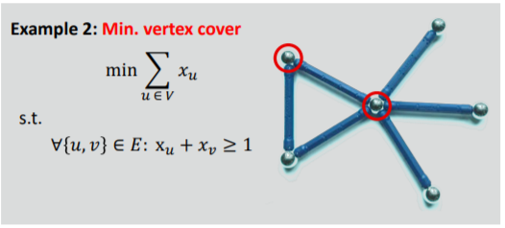
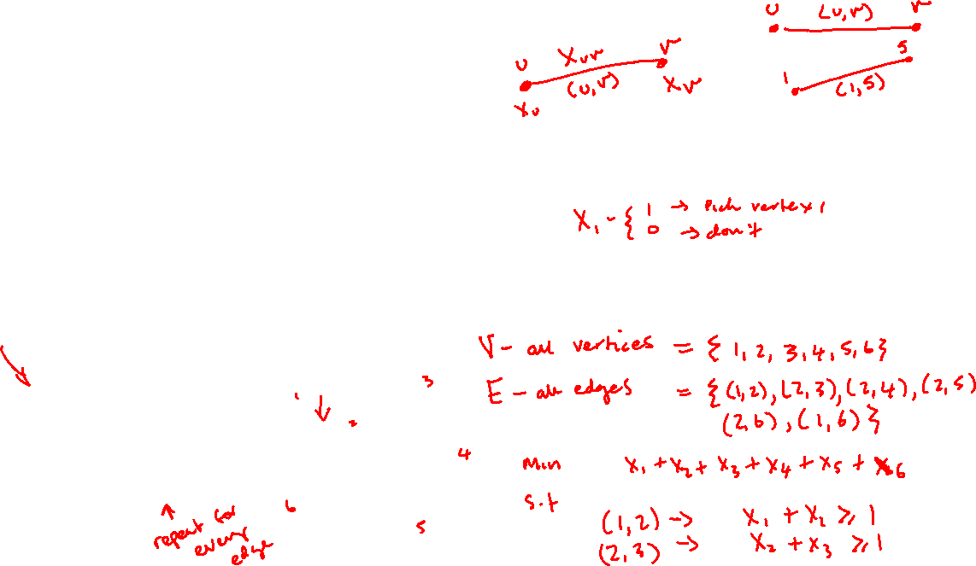
Minimum Vertex Cover

Slide 15
Example – Installing Security Cameras
You wish to install security cameras in a school to cover every corridor.
Obviously you would like to install as few as needed
The following example is from https://brilliant.org/wiki/vertex-cover/

Slide 16

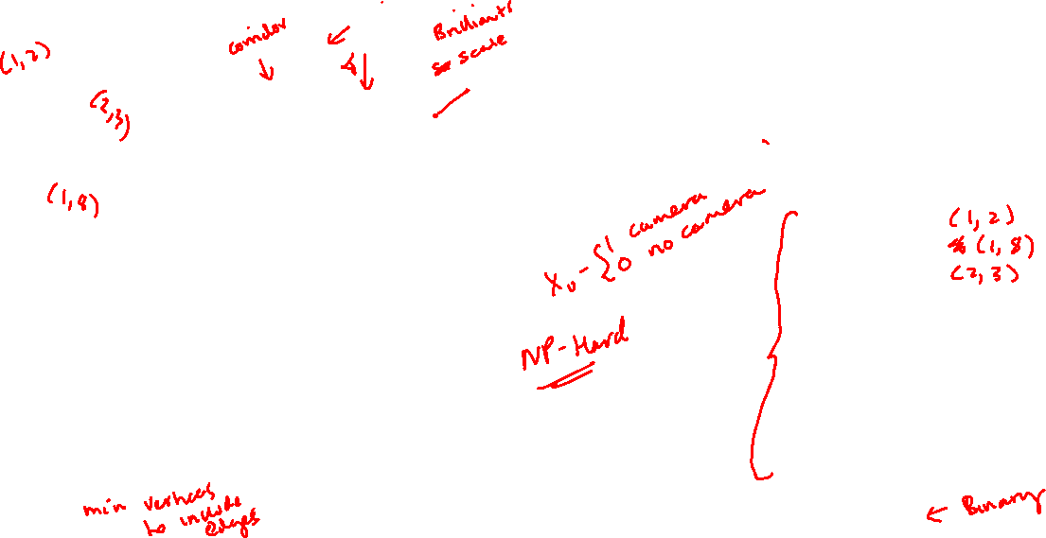
Example – Installing Security Cameras
4
2
minimise
$$\sum_{u∈V}{x_{u}}=x_{1}+x_{2}+x_{3}+x_{4}+x_{5}+x_{6}+x_{7}+x_{8}$$
subject to:
$$x_{1}+x_{2}≥1$$
$$x_{1}+x_{8}≥1 \\ x_{2}+x_{3}≥1$$
$$x_{2}+x_{5}≥1 \\ x_{3}+x_{4}≥1 \\ x_{4}+x_{5}≥1 \\ x_{5}+x_{6}≥1$$
$$x_{5}+x_{8}≥1 \\ x_{6}+x_{7}≥1 \\ x_{7}+x_{8}≥1$$
$$x_{u}∈\{0,1\}$$
1
3
6
5
7
8

Slide 17
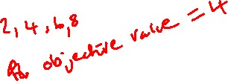
Example – Installing Security Cameras
4
2
minimise
$$\sum_{u∈V}{x_{u}}=x_{1}+x_{2}+x_{3}+x_{4}+x_{5}+x_{6}+x_{7}+x_{8}$$
subject to:
$$x_{1}+x_{2}≥1$$
$$x_{1}+x_{8}≥1 \\ x_{2}+x_{3}≥1$$
$$x_{2}+x_{5}≥1 \\ x_{3}+x_{4}≥1 \\ x_{4}+x_{5}≥1 \\ x_{5}+x_{6}≥1$$
$$x_{5}+x_{8}≥1 \\ x_{6}+x_{7}≥1 \\ x_{7}+x_{8}≥1$$
$$x_{u}∈\{0,1\}$$
1
3
6
5
7
8
MATLAB Solution

Slide 18
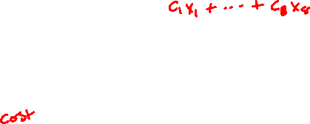
Example – Installing Security Cameras
4
2
minimise
$$\sum_{u∈V}{x_{u}}=x_{1}+x_{2}+x_{3}+x_{4}+x_{5}+x_{6}+x_{7}+x_{8}$$
subject to:
$$x_{1}+x_{2}≥1$$
$$x_{1}+x_{8}≥1 \\ x_{2}+x_{3}≥1$$
$$x_{2}+x_{5}≥1 \\ x_{3}+x_{4}≥1 \\ x_{4}+x_{5}≥1 \\ x_{5}+x_{6}≥1$$
$$x_{5}+x_{8}≥1 \\ x_{6}+x_{7}≥1 \\ x_{7}+x_{8}≥1$$
$$x_{u}∈\{0,1\}$$
1
3
6
5
7
8
Another possibility

Slide 19
Maximum Weight Matching and Assignment Problem

Slide 20
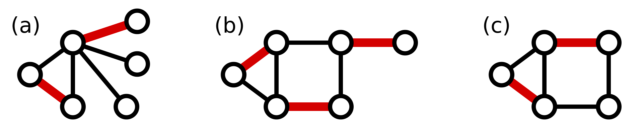
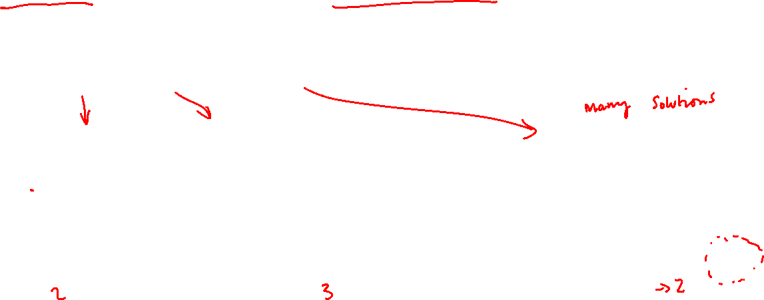

Maximum Matching
Matching – Set of edges without common vertices
Maximum Matching – Matching with the largest number of edges
Examples of Maximum Matchings

Slide 21
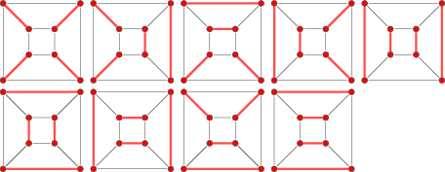
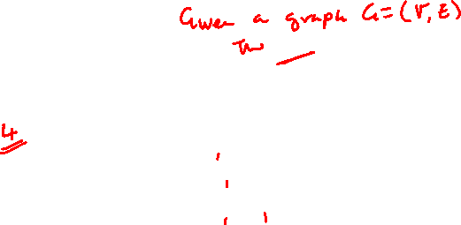
Perfect Matching
Matching – Set of edges without common vertices
Perfect Matching – Matching that includes every vertex
Examples

Slide 22
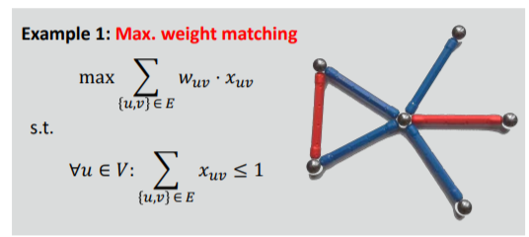
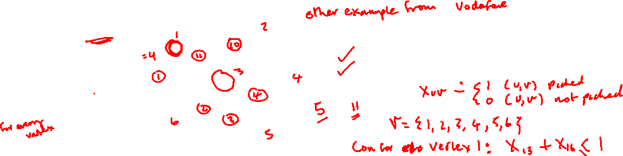
Maximum Weight Matching
Select a set of edges without common vertices
Maximise the weight of the edges

Slide 23
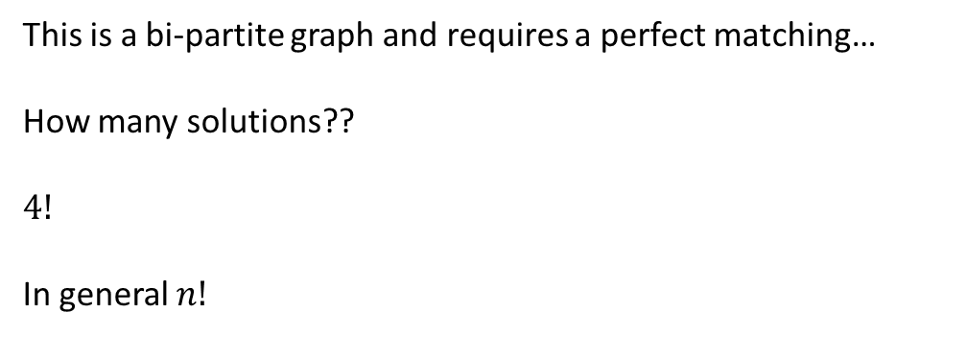
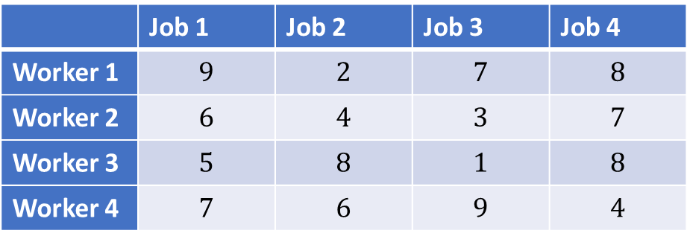
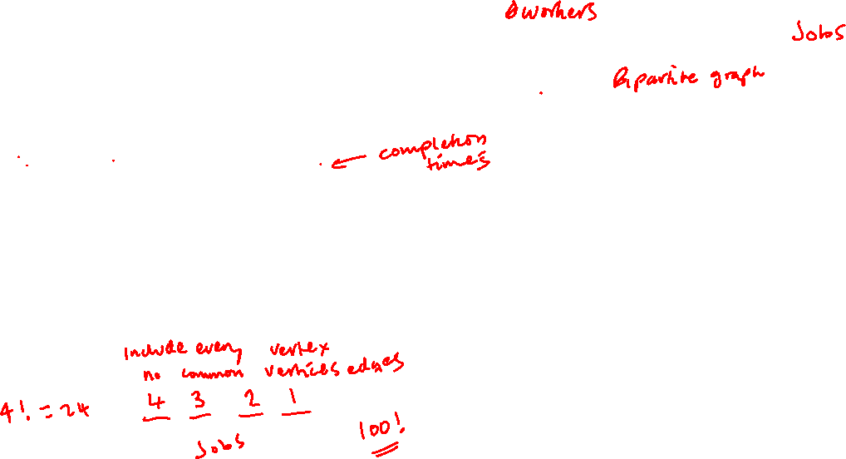
Balanced Assignment Problem
Assign a worker to each job – minimise completion time
1
1
 | Job 1 | Job 2 | Job 3 | Job 4
Worker 1 | $$9$$ | $$2$$ | $$7$$ | $$8$$
Worker 2 | $$6$$ | $$4$$ | $$3$$ | $$7$$
Worker 3 | $$5$$ | $$8$$ | $$1$$ | $$8$$
Worker 4 | $$7$$ | $$6$$ | $$9$$ | $$4$$
2
2
This is a bi-partite graph and requires a perfect matching…
How many solutions??
$$4!$$
In general $n!$
3
3
4
4

Slide 24
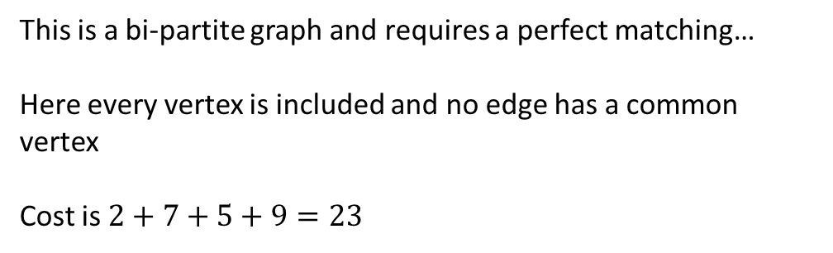
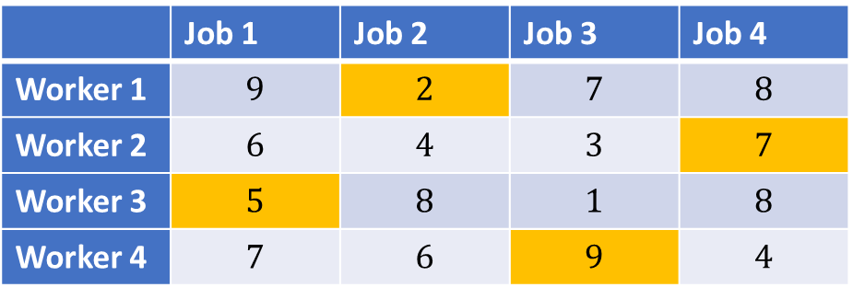
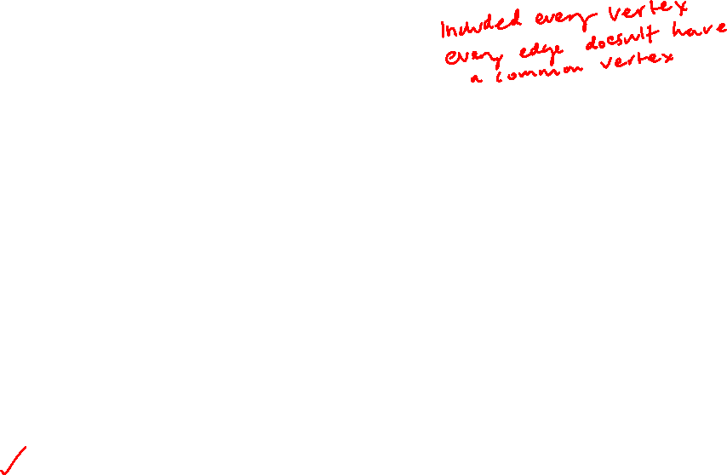
Balanced Assignment Problem
Example Solution
1
1
 | Job 1 | Job 2 | Job 3 | Job 4
Worker 1 | $$9$$ | $$2$$ | $$7$$ | $$8$$
Worker 2 | $$6$$ | $$4$$ | $$3$$ | $$7$$
Worker 3 | $$5$$ | $$8$$ | $$1$$ | $$8$$
Worker 4 | $$7$$ | $$6$$ | $$9$$ | $$4$$
2
2
This is a bi-partite graph and requires a perfect matching…
Here every vertex is included and no edge has a common vertex
Cost is $2+7+5+9=23$
3
3
4
4

Slide 25

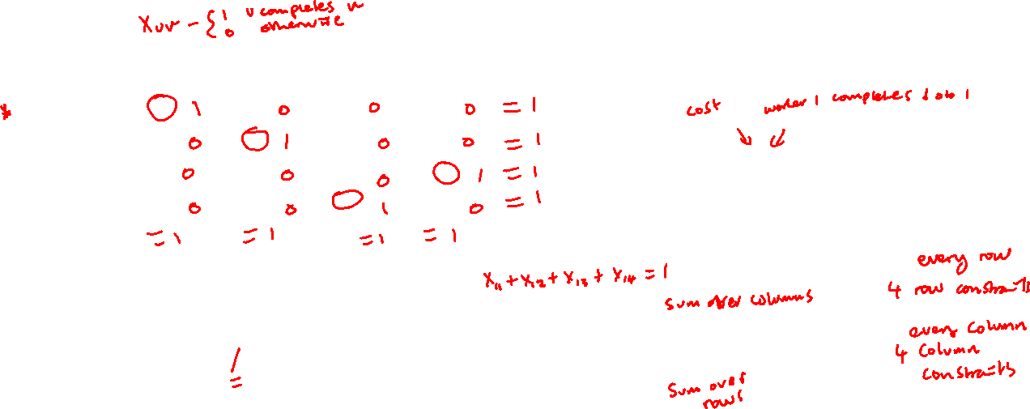
Balanced Assignment Problem – Model
Pick 1 Per Row and 1 Per column
$W$- Set of Workers
$J$ - Set of Jobs
$x_{uv}$ - Worker $u$ completes job $v$
$c_{uv}$ - Completion time for worker $u$ completing job $v$
minimise
$$\sum_{u∈W}{\sum_{v∈J}{{c_{uv}x}_{uv}}} ={c_{11}x}_{11}+{c_{12}x}_{12}+… \\ +{c_{uv}x}_{uv}+…+{c_{44}x}_{44}$$
subject to:
$$\sum_{v∈j}{x_{uv}=1}, ∀u∈W$$
$$\sum_{u∈W}{x_{uv}=1}, ∀v∈J$$
$$x_{uv}∈\{0,1\}$$
 | Job 1 | Job 2 | Job 3 | Job 4
Worker 1 | $$9$$ | $$2$$ | $$7$$ | $$8$$
Worker 2 | $$6$$ | $$4$$ | $$3$$ | $$7$$
Worker 3 | $$5$$ | $$8$$ | $$1$$ | $$8$$
Worker 4 | $$7$$ | $$6$$ | $$9$$ | $$4$$

Slide 26
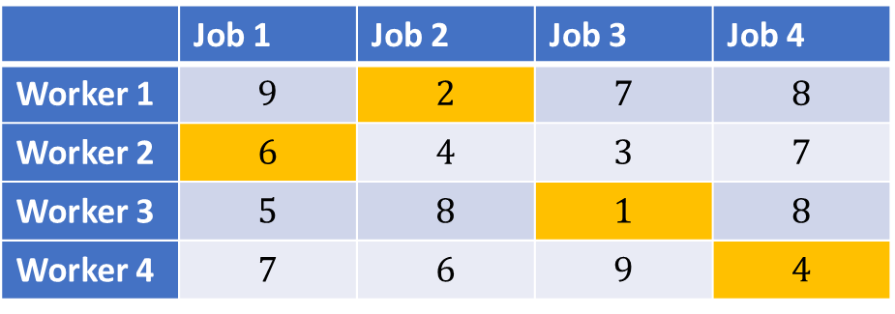
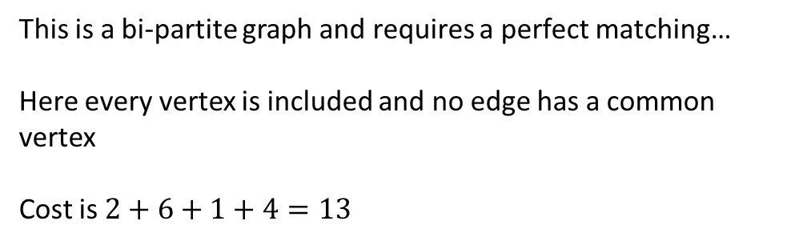
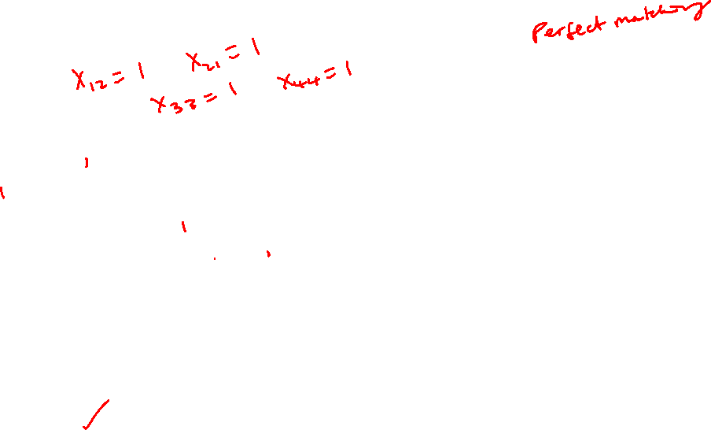
Balanced Assignment Problem
Optimal Solution
1
1
 | Job 1 | Job 2 | Job 3 | Job 4
Worker 1 | $$9$$ | $$2$$ | $$7$$ | $$8$$
Worker 2 | $$6$$ | $$4$$ | $$3$$ | $$7$$
Worker 3 | $$5$$ | $$8$$ | $$1$$ | $$8$$
Worker 4 | $$7$$ | $$6$$ | $$9$$ | $$4$$
2
2
This is a bi-partite graph and requires a perfect matching…
Here every vertex is included and no edge has a common vertex
Cost is $2+6+1+4=13$
3
3
4
4

Slide 27
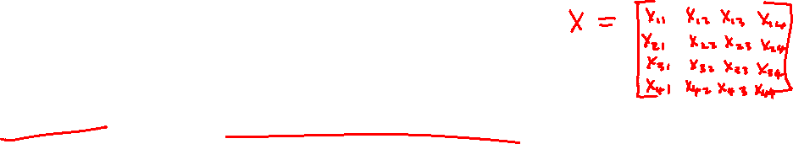
Assignment Problem
Assign 3 students to the 3 different dissertation projects.
s1
p1
s1
p1
s2
p2
s1
p2
s3
p3
s1
p3

Slide 28
Homework
Study these models and understand the MATLAB code. It will be useful for coming lectures.
Try coding these yourself.
Look up other problems such as.
Maximum Set Cover
Maximum Edge Cover
Maximum Independent Set
Look at the examples on Gurobi
https://www.gurobi.com/resource/modeling-examples-using-the-gurobi-python-api-in-jupyter-notebook/
A lot of these are taken from ‘Model Building in Mathematical Programming’, by H. Paul Williams

